Slide 1
HTB sherlocks - Bumblebee
Write up by Chanan Shenker

Slide 2
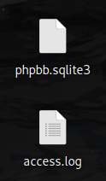


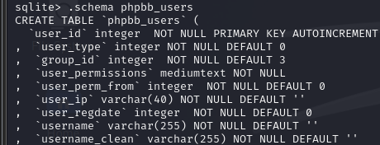


Start:
We start with a access.log file and a sqlite3 file.
An access.log file is file that logs all HTTP request coming into a web server. Sqlite3 is a commonly used, Lightweight, serverless and simple configuration SQL database.
With that said let get on with the questions.
Task 1: What was the username of the external contractor?
To start we can enter the database with the ‘sqlite3’ command, once we are in we can run the .tables command to list all tables in the database. When searching I found the ‘phpbb_users’ table. Next we can use the .schema to see waht keys(they hold the information) there are. I looked through the table and found an email with the ending ‘contartor.net’ so I submitted it and got a right answer
Answer 1: apoole1

Slide 3


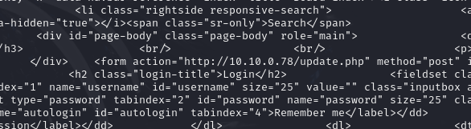
Task 2: What IP address did the contractor use to create their account?
Looking at the other values in the table we can see a user_ip key. And when searching for it with the username we got, we get the users IP address.
Answer 2: 10.10.0.78
Task 3: What is the post_id of the malicious post that the contractor made?
When looking back at all the table I saw a table named ‘phpbb_posts’. When looking at the schema we can see a key named ‘posts_id’. When searching for the IP address we got from the previous task we can find the post id.
Answer 3: 9
Task 4: What is the full URI that the credential stealer sends its data to?
When looking at the schema again we can see a key named post_text, since this is a “log” of all posts made to the server we can maybe find it here. When looking I found a url with the contractors IP.
Answer 4: http://10.10.0.78/update.php

Slide 4

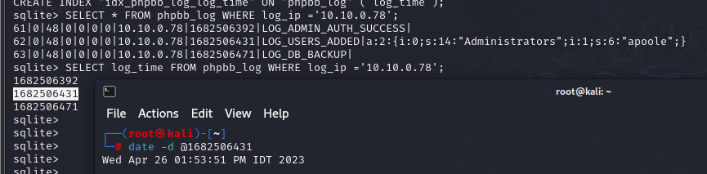
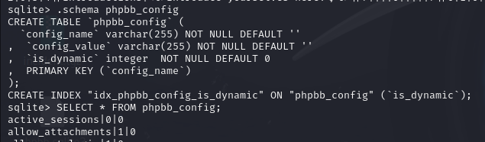

Task 5: When did the contractor log into the forum as the administrator? (UTC)
When looking through the tables again we see a table named phpbb_log.
It took me a while since I first looked through the login attempts tables but found nothing
Looking at the schema I found the log_time and the log_ip in the phpbb_log table. When looking for the IP we get an epoch time value(seconds since 1/1/1970).
We can also see the LOG_ADMIN_AUTH_SUCCESS that helps us.
All thats left is to convert to UTC.
Answer 5: 26/04/2023 10:53:12
Task 6: In the forum there are plaintext credentials for the LDAP connection, what is the password?
This one took me a while since I looked at other tables that made sense for me first, but after a lot of digging I found the phpbb_config table.
And once looking through the table I found a value named “ldap_password”
Answer 6: Passw0rd1

Slide 5

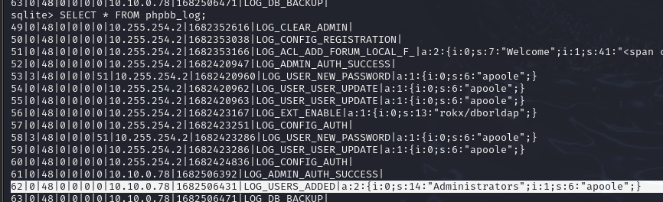
Task 7: What is the user agent of the Administrator user?
For this we go back to the phpbb_users tables and search for the admins ip, once we get that we can go look at the access.log file.
When searching fo the admin IP address we can see the user agent the admin uses.
Answer 7: Mozilla/5.0 (Macintosh; Intel Mac OS X 10_15_7) AppleWebKit/537.36 (KHTML, like Gecko) Chrome/112.0.0.0 Safari/537.36
Task 8: What time did the contractor add themselves to the Administrator group? (UTC)
For this we look back at the phpbb_log table. When searching through we see a value about adding users with the contractors IP address.
And again we get an epoch value and we can convert it to get the answer.
Answer 8: 26/04/2023 10:53:51

Slide 6
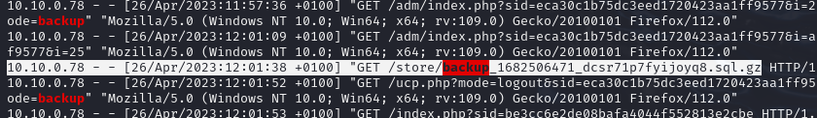
Task 9: What time did the contractor download the database backup? (UTC)
Going back to the access.log file we can search for the contractors IP address and for any logs with the word backup.
We can see here a log with a GET request for the URI /store/backup….sql.gz
The sql tells us it’s a database being downloaded. Once we convert the time to UTC we get the answer.
Answer 9: 26/04/2023 11:01:38
Task 10: What was the size in bytes of the database backup as stated by access.log?
looking back at the log, next to the URI we can see the size of the response in bytes.
Answer 10: 34707

Slide 7


